Slide 1

Facilitation of the A Posteriori Replication of Web Published Satellite Imagery
Mat Kelly
Web Science and Digital Libraries Research Lab
Old Dominion University
mkelly@cs.odu.edu
Virginia Space Grant Consortium Student Research Conference
NASA Langley Research Center
April 17, 2015

Slide 2
Outline
Background & Motivation
Target Data & Technologies Used
How It All Fits Together
Results

Slide 3
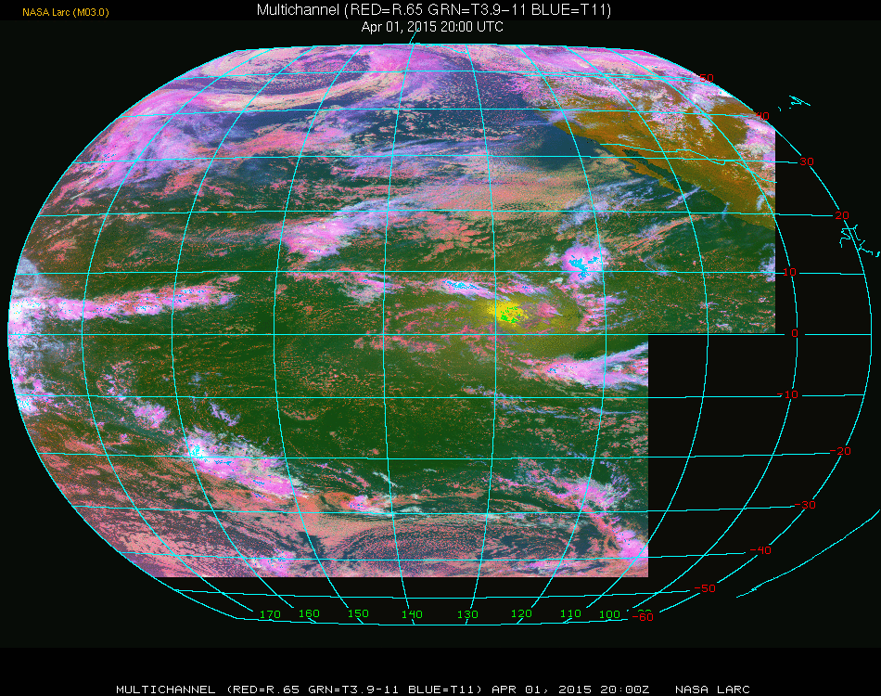
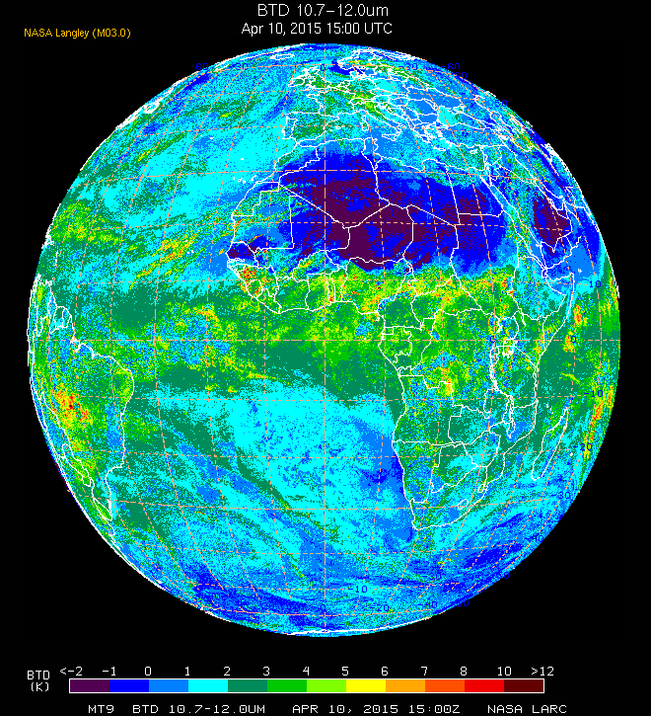
Background: NASA Satellite Imagery
Web Published
http://www-pm.larc.nasa.gov
Used by atmospheric scientists
Data set monotonically increasing in size
Older data archived
Available on-demand but slower

Slide 4

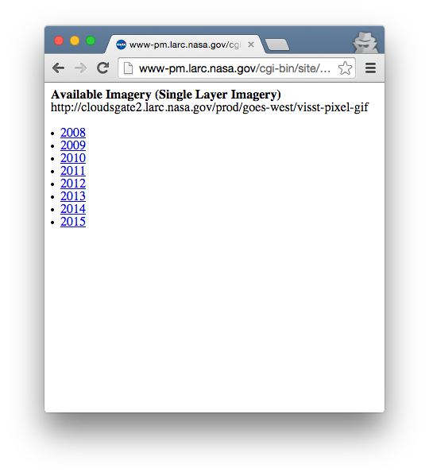
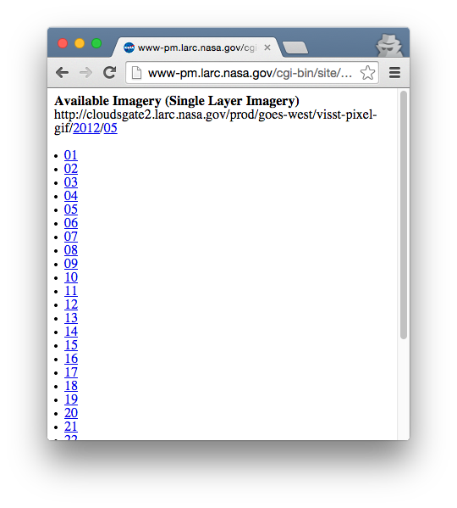
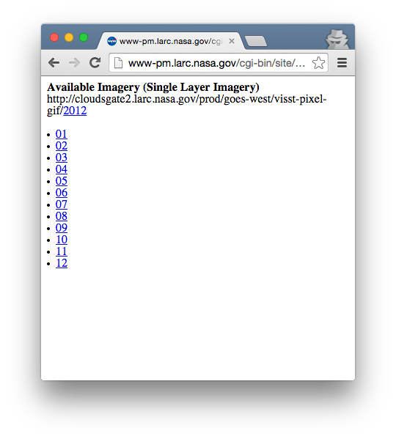
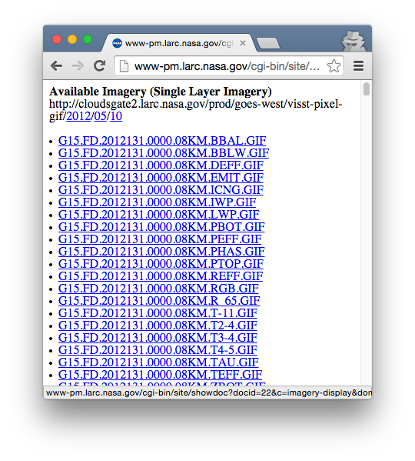
Main Issue
Data is centrally located
Single point of failure
Data is public domain
Duplication by users is no issue
Temporally organized with nested directories
No exposed APIs or access technologies used for external interface

Slide 5
The Objective the title explained
Facilitation of the A Posteriori Replication of Web Published Satellite Imagery

Slide 6
The Objective the title explained
Facilitation of the A Posteriori Replication of Web Published Satellite Imagery

Slide 7

The Objective the title explained
Facilitation of the A Posteriori Replication of Web Published Satellite Imagery

Slide 8
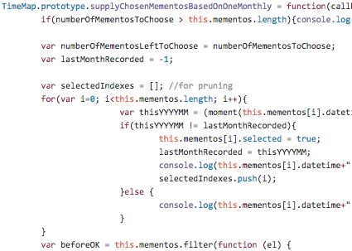
The Objective the title explained
Facilitation of the A Posteriori Replication of Web Published Satellite Imagery
No internal
code changes

Slide 9
Outline
Background & Motivation
Target Data & Technologies Used
How It All Fits Together
Results

Slide 10
Current Organization of Imagery Data on LaRC servers
List of image files
→
YEAR →
MONTH→
DAY→

Slide 11





Technologies Used
ResourceSync
Specification for synchronizing files on the Web
BitTorrent
Peer-to-peer file sharing with file partitioning and hashing
WebRTC
Protocol for browser-based peer-to-peer communication that can circumvent NATs
Logos comply with licenses or used with a fair use rationale

Slide 12
Outline
Background & Motivation
Target Data & Technologies Used
How It All Fits Together
Results

Slide 13
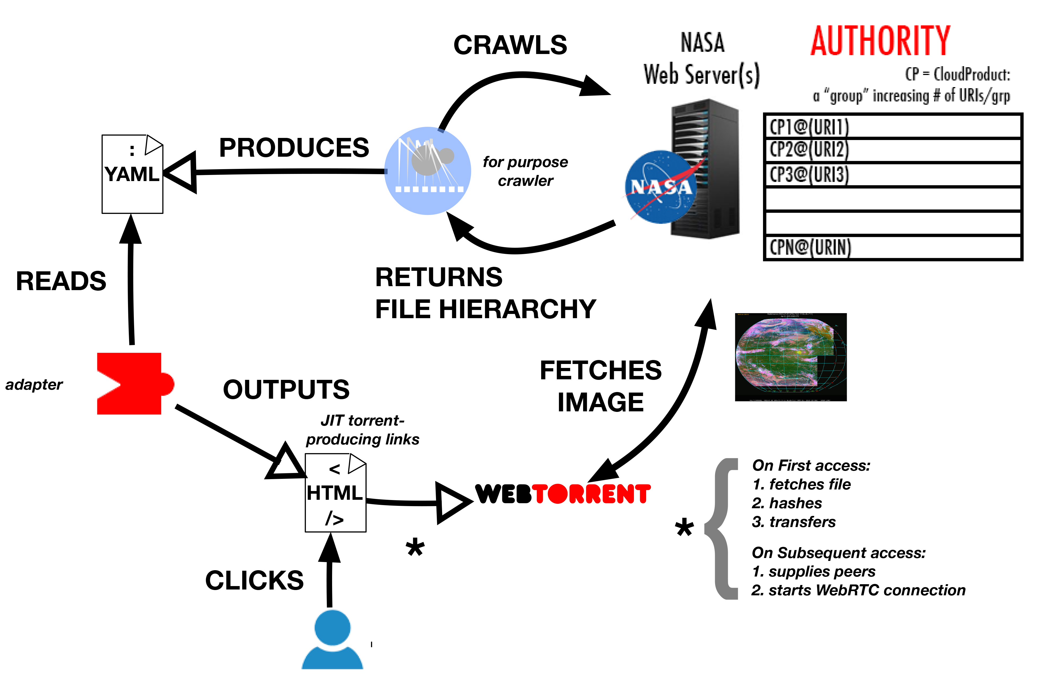

Slide 14
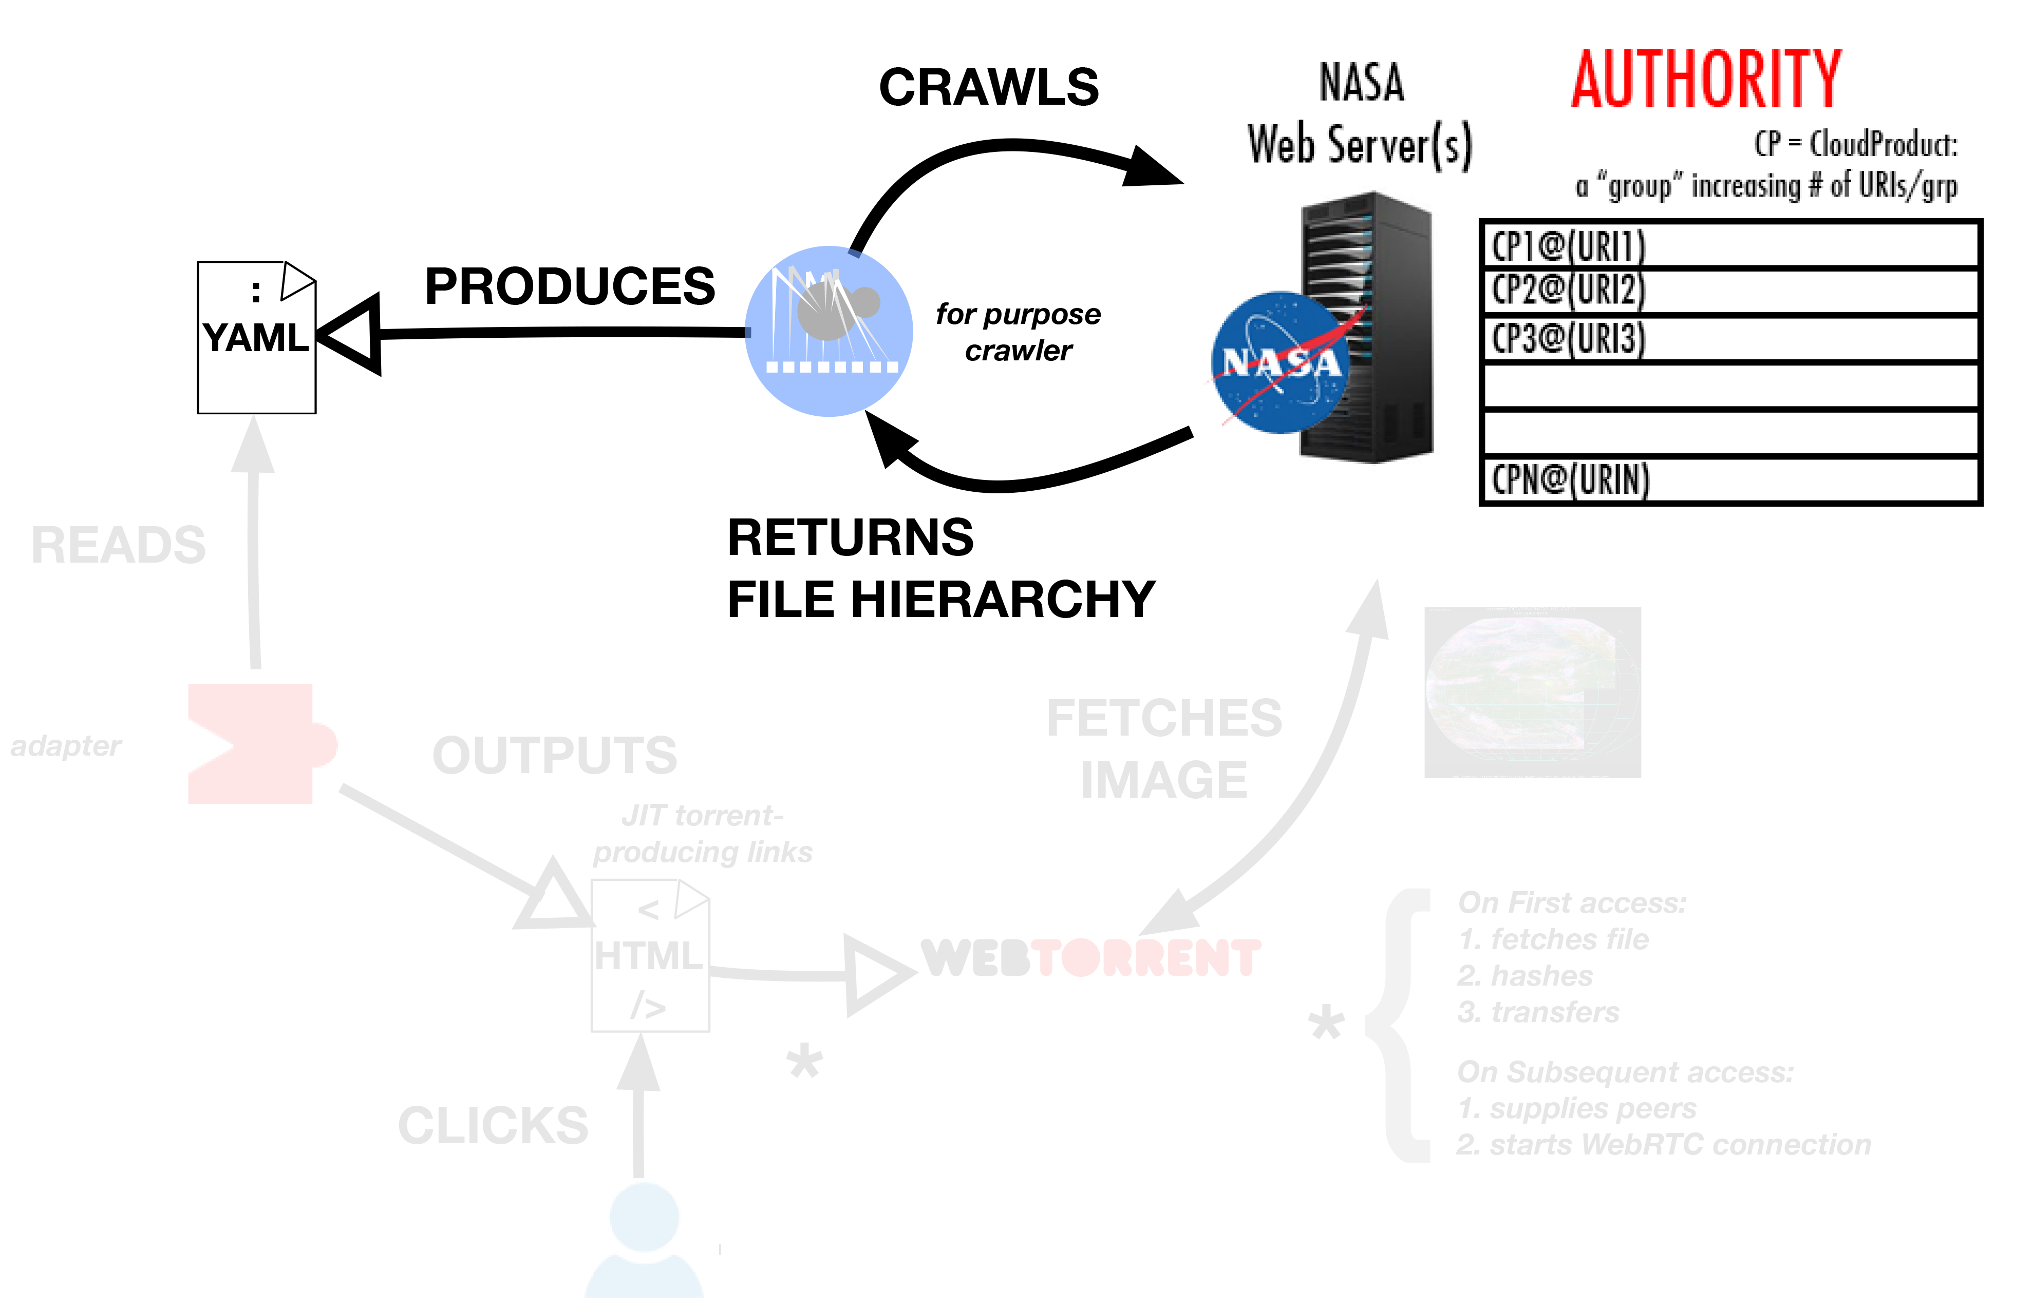

Slide 15
The For-Purpose Crawler
Discovers imagery resources on LaRC servers
Produces YAML metadata for consumption by other tools
Output represents locations of payload (imagery)

Slide 17
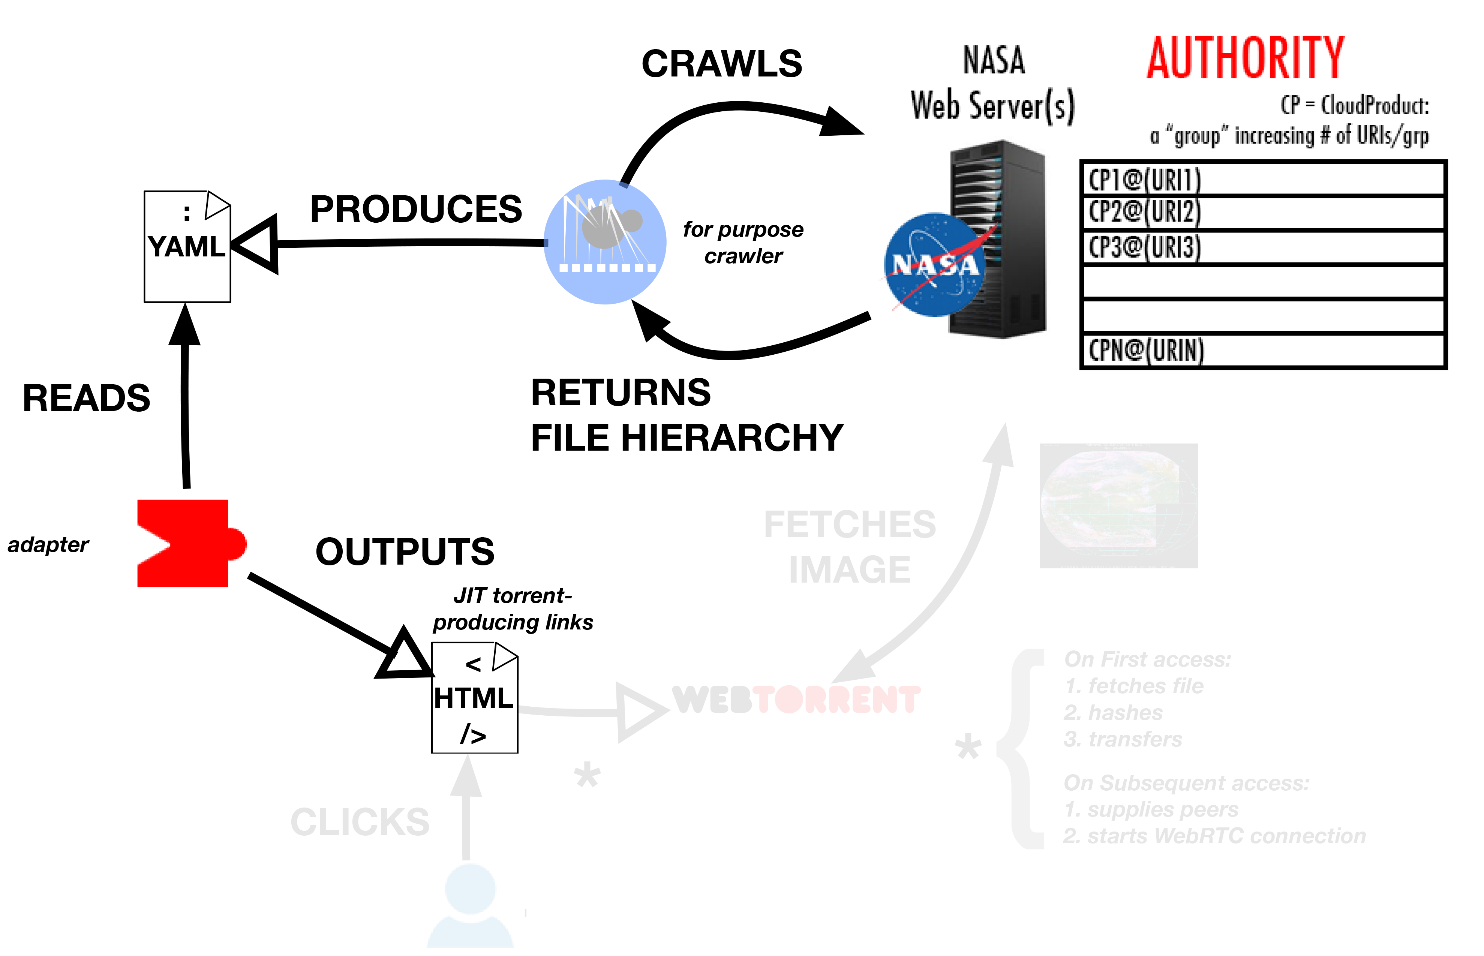

Slide 18

Consuming the Metadata
Adapter software converts human-readable YAML to HTML-style directives
Directives invoke webtorrent when selected
Intermediary YAML allows for extensible data set
Important as new data is generated and crawled

Slide 20
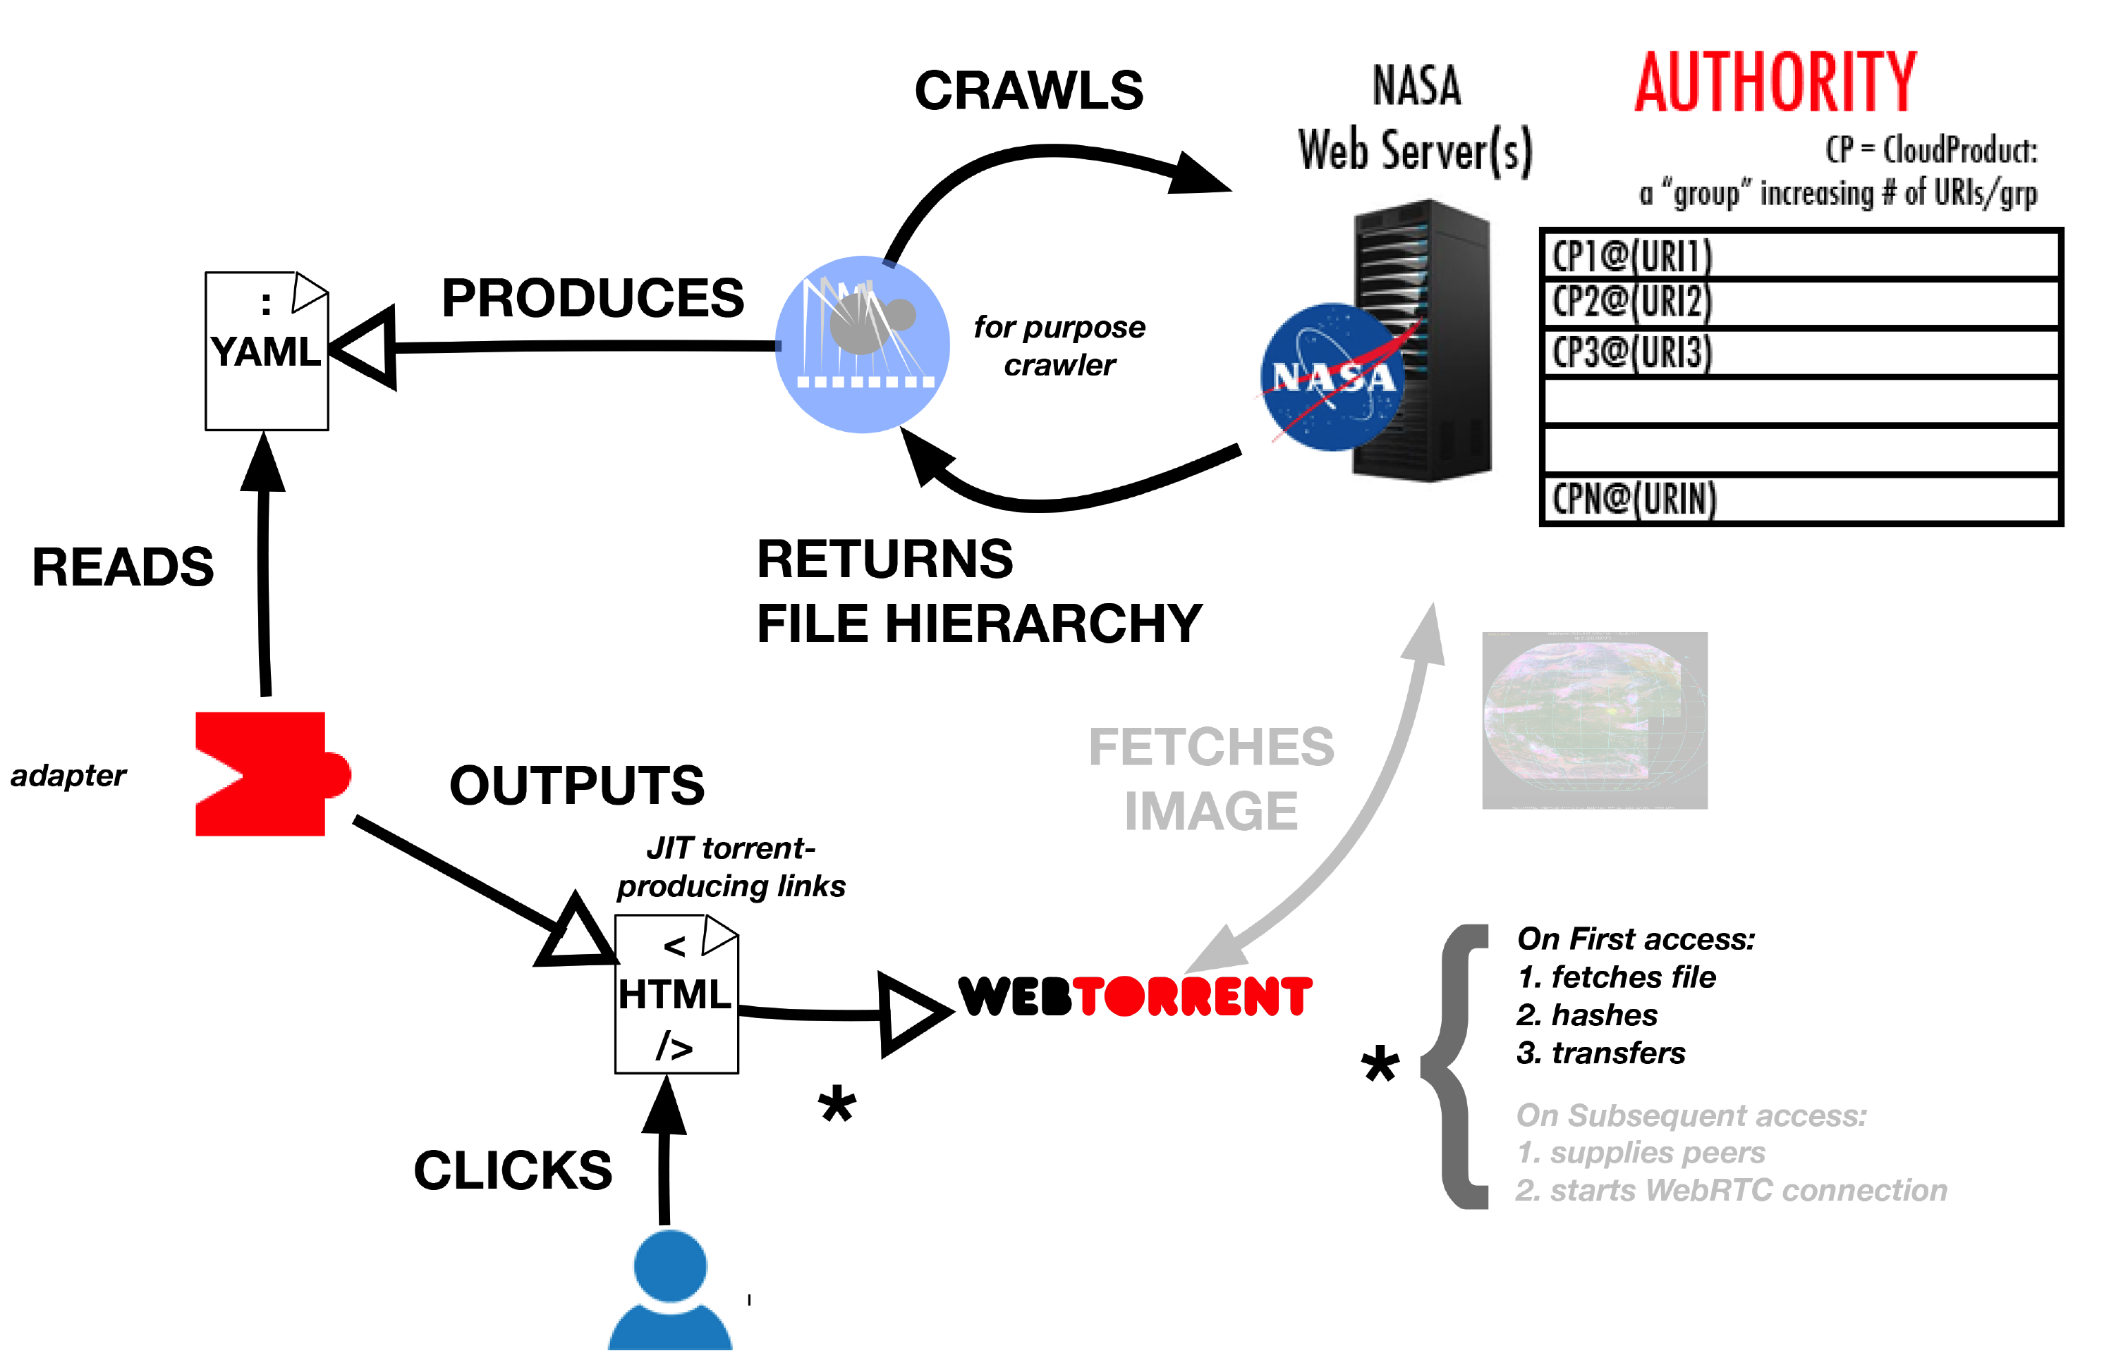

Slide 21
End-User Interfacing
User accesses an interface populated with webtorrent-invoking links

Slide 23
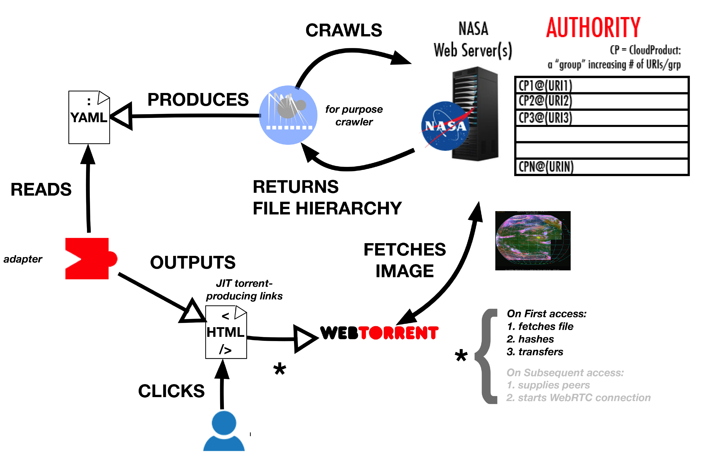

Slide 24
Payload Fetch and Hashing
webtorrent fetches content, hashes and seeds to invoking user

Slide 25
Payload Fetch and Hashing
User’s original invocation is answered with payload
User automatically starts seeding via WebRTC

Slide 28
Payload Fetch and Hashing
After initial seed, webtorrent returns peer list instead of payload

Slide 29
Payload Fetch and Hashing
From this peer list, users can disseminate data
Access from further users results in a larger list of peer

Slide 31
Outline
Background & Motivation
Target Data & Technologies Used
How It All Fits Together
Results

Slide 32
Evaluation
Proof-of-concept constructed
Temporally expensive but effective crawler operation
No means of evaluating NASA load
A Posteriori: this is out-of-scope

Slide 33
Conclusions / Future Work
Simpler cases functioned well for proof-of-concept
Reliance on single source of data mitigated
ResourceSync concepts but not technology not integrated
YAML not exercised to potential

Slide 34
Facilitation of the A Posteriori Replication of Web Published Satellite Imagery
Mat Kelly
Web Science and Digital Libraries Research Lab
Old Dominion University
mkelly@cs.odu.edu
Virginia Space Grant Consortium Student Research Conference
NASA Langley Research Center
April 17, 2015

